Slide 1
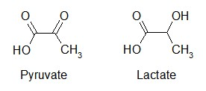

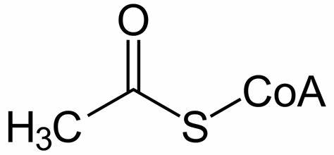

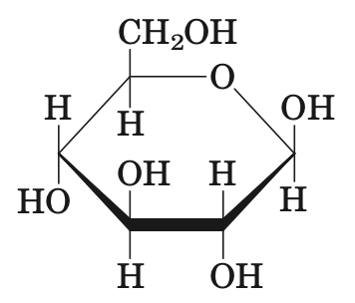
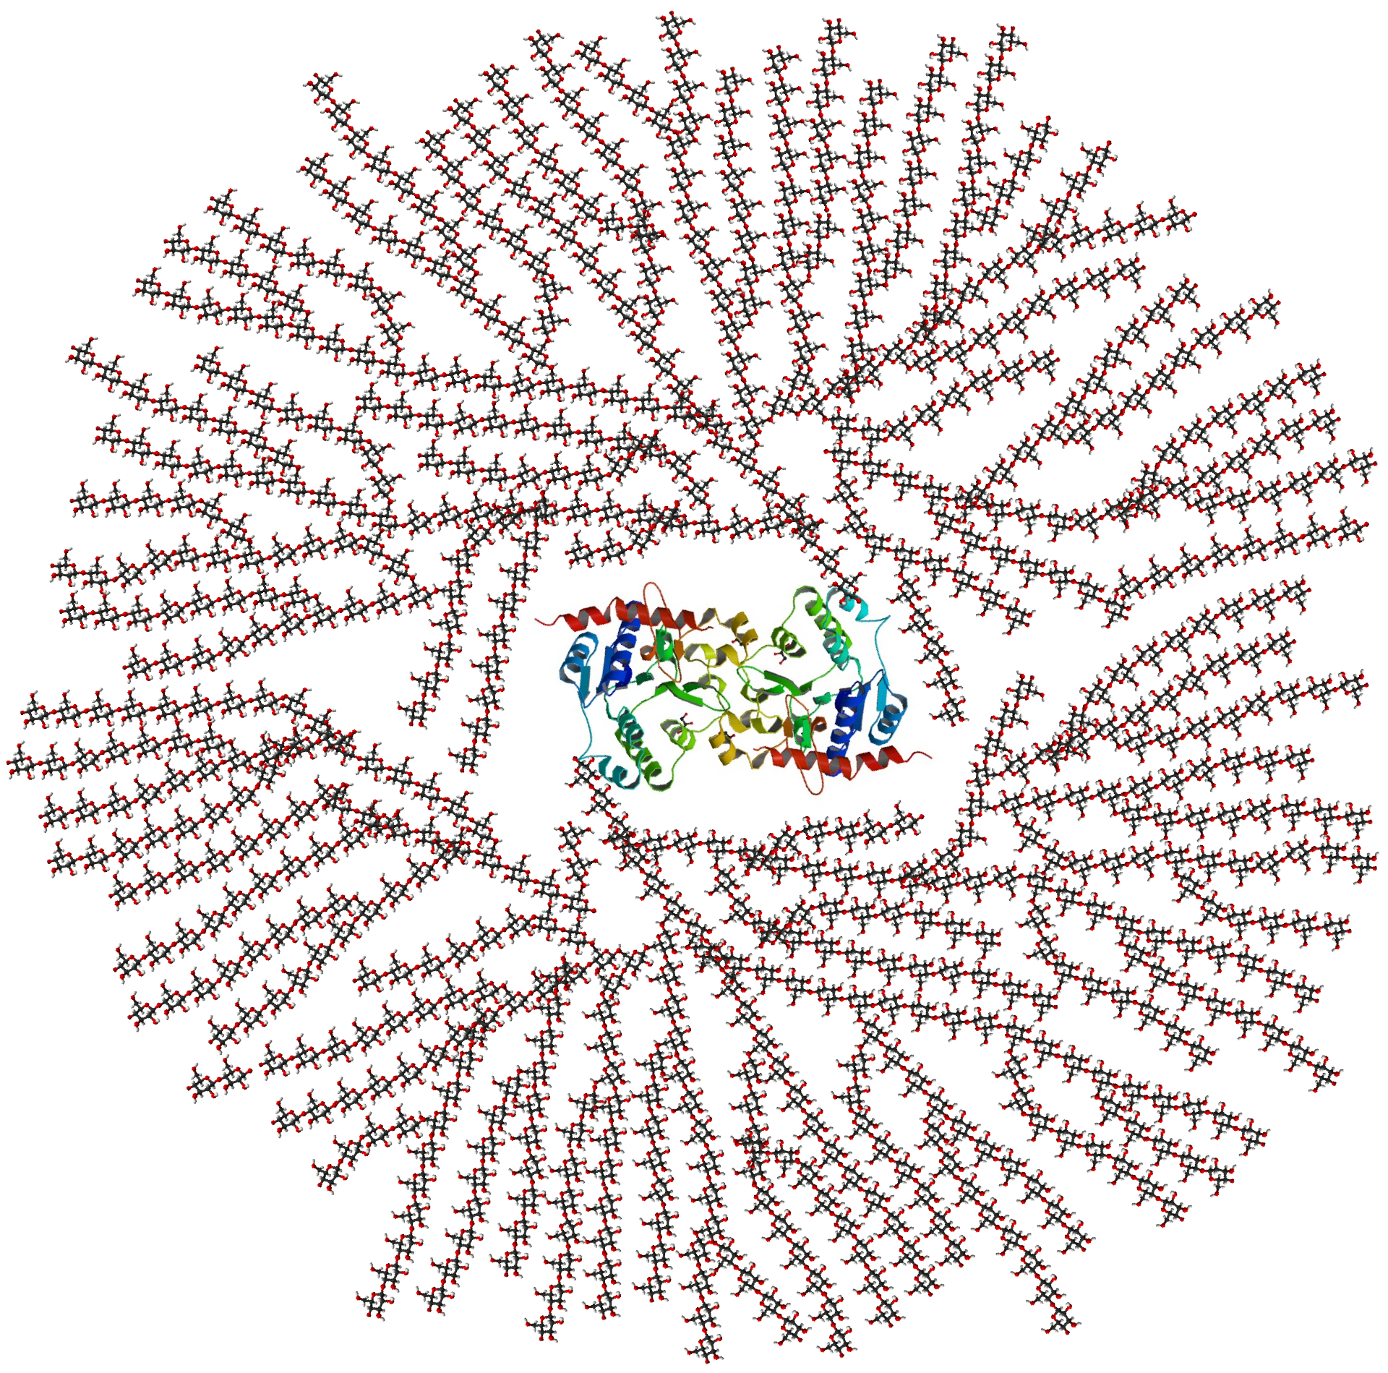
The synthesis of carbohydrate:
Gluconeogenesis, Photosynthesis and Glycogen synthesis
Pyruvate/lactate
glucagon
Insulin
Gluconeogenesis
Light
Glyoxylate cycle
Glycogen synthesis
Acetyl-CoA
Glucose
Glycogen
In plants
Photosynthesis
ATP
Calvin Cycle
NADPH + H⁺
Biology Preparatory Course Class 9

Slide 2
Gluconeogenesis
Pyruvate
Lactate
Pyruvate
Pyruvate
CO₂
Pyruvate
ATP
Pyruvate carboxylase
CO₂
ADP+Pi
ATP
Pyruvate carboxylase
Oxaloacetate
ADP+Pi
NADH+H⁺
Mitochondrial
Malate dehydrogenase
Oxaloacetate
NAD⁺
GTP
Mitochondrial PEP carboxykinase
Glucose
Malate
GDP+Pi
CO₂
PEP
Glucose
6-phosphatase
Malate
NAD⁺
Cytosolic
Malate dehydrogenase
Glucose 6-phosphate
NADH+H⁺
Oxaloacetate
PEP carboxykinase
Fructose 1,6-phosphatase
GTP
PEP
Gluconeogenesis
Fructose 1,6-biphosphate
GDP+Pi
CO₂
Glycolysis

Slide 3
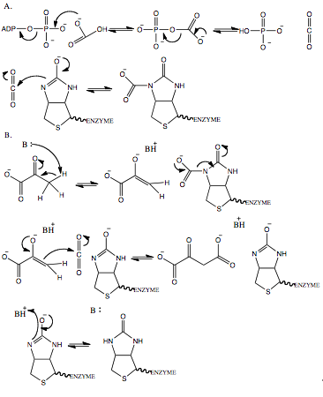
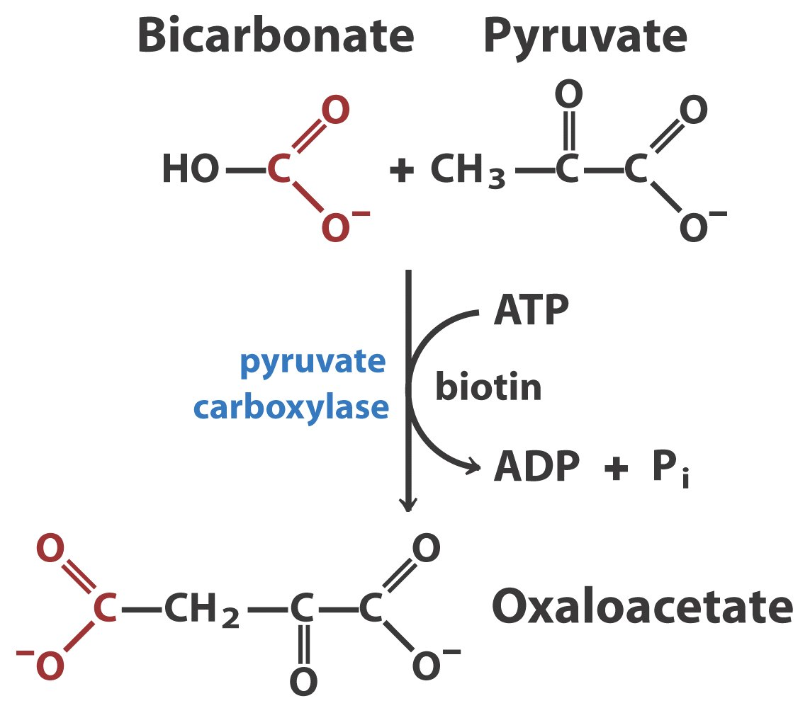
Pyruvate carboxylase
Pyruvate carboxylase: the first regulatory enzyme in gluconeogenesis, requires acetyl-CoA as a positive effector
Biotin is a crucial part of carboxylase, which carries carboxyl group and transport it to substrate. In this process, one unit of ATP is consumed.
https://en.wikipedia.org/wiki/Pyruvate_carboxylase

Slide 4
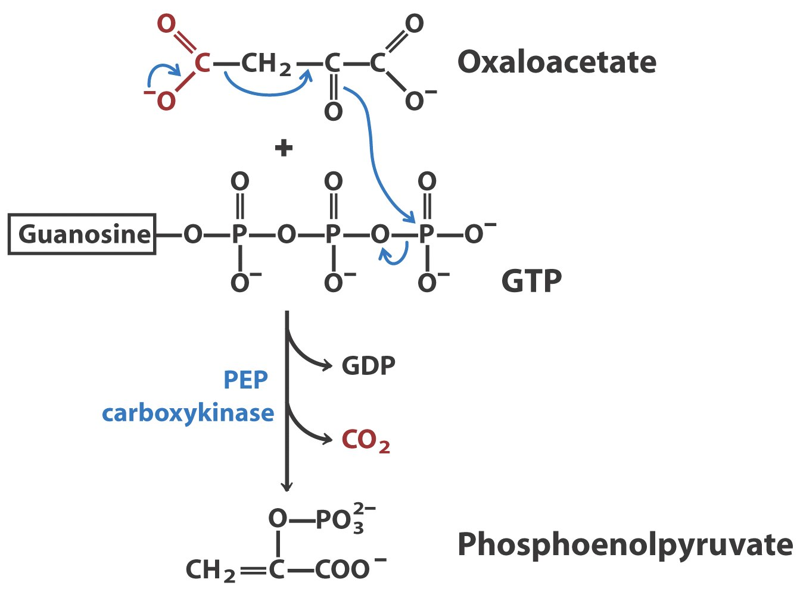
PEP Carboxykinase
This enzyme located both in cytosol and mitochondria. If the material of gluconeogenesis is lactate, oxaloacetate is converted to PEP in mitochondria, because the oxidation of lactate will release NADH in the cytosol. Therefore, cell doesn’t need bring NADH out of mitochondria by malate.

Slide 5
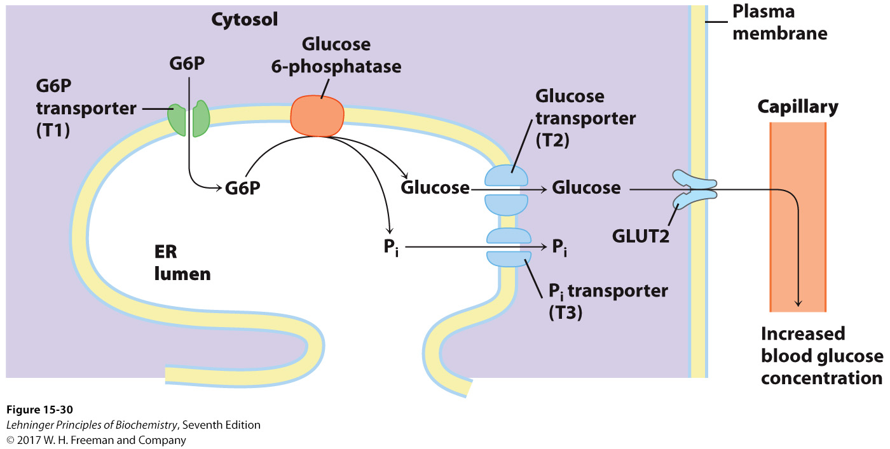
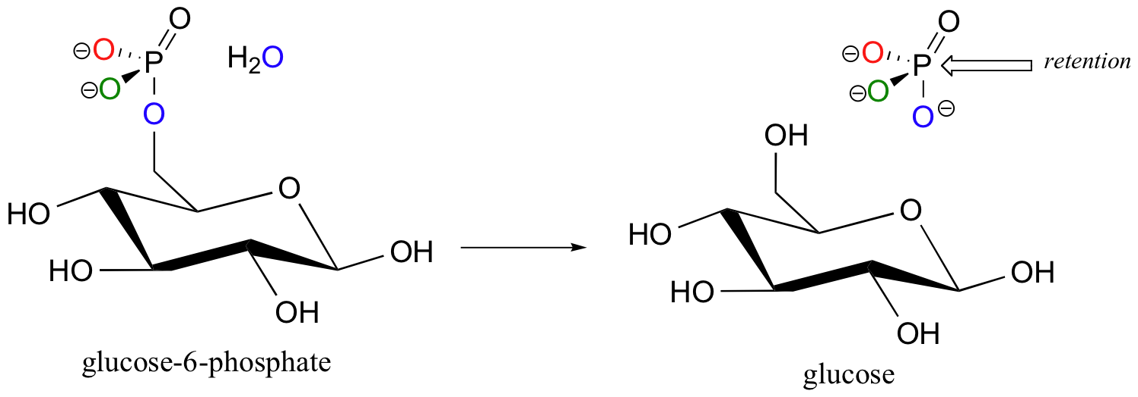
Glucose 6-biphophatase
This enzyme catalyzes one important irreversible reaction --- from glucose 6-phosphate to glucose, which makes the final product of gluconeogenesis can be released in blood.
The enzyme is a membrane protein located in endoplasm reticulum. However, it is absent in muscle cells, because glucose in muscle is mainly consumed by itself whereas hepatocyte should release glucose in blood to regulate blood glucose concentration.

Slide 6
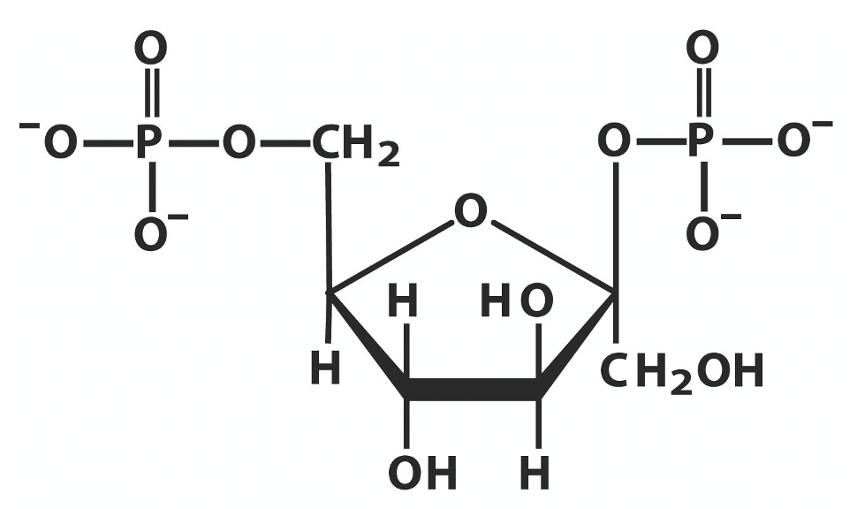
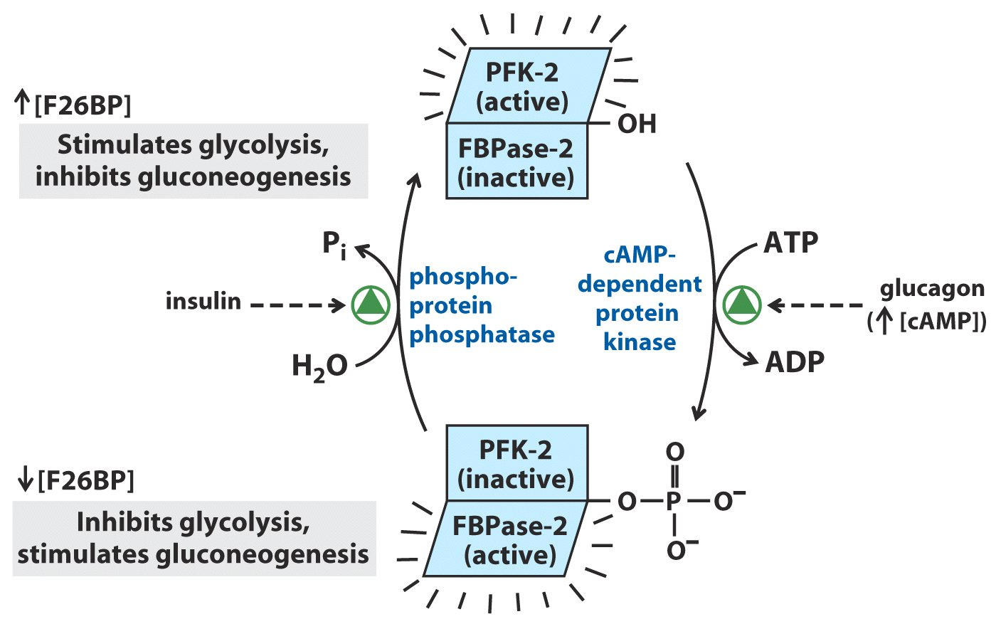
Fructose 1,6-phosphatase and PFK-2
Fructose 1,6-biphosphate
Fructose 1,6-phosphatase
Fructose 6-phosphate
Fructose 2,6-biphosphate plays a central role in the regulation of gluconeogenesis and glycolysis. PFK-2 is a single enzyme which contains two reverse activity, kinase and phosphatase activity. Insulin and glucagon regulate the relative activity of PFK-2 reversible phosphorylation.
Some details are showed in the figure.
Pi
Fructose 2,6-phosphate
PFK-2
activity
Fructose
2,6-biphosphatase activity
Insulin
Glucagon
Fructose 6-biphosphate

Slide 7
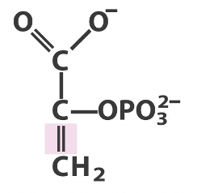
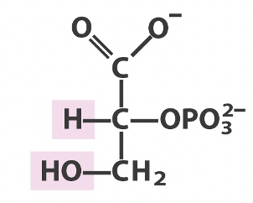
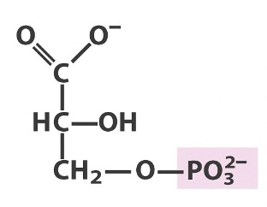
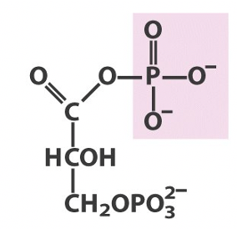
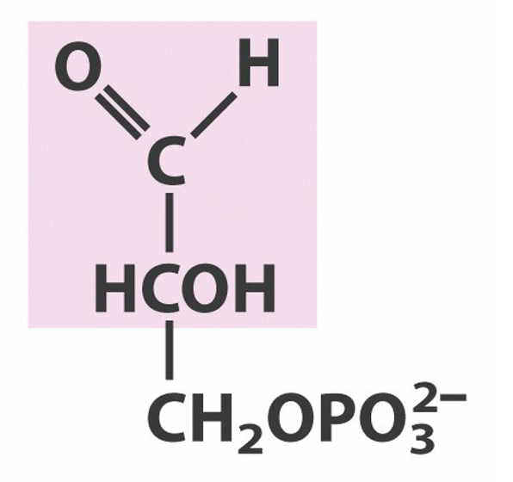
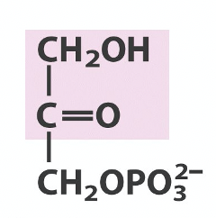
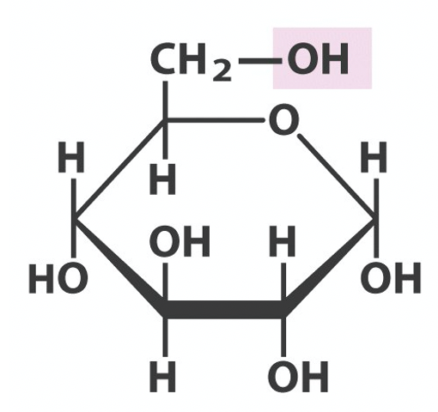
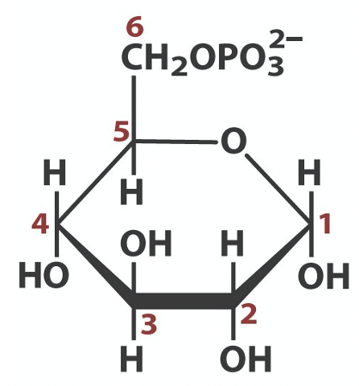
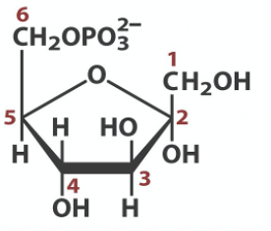
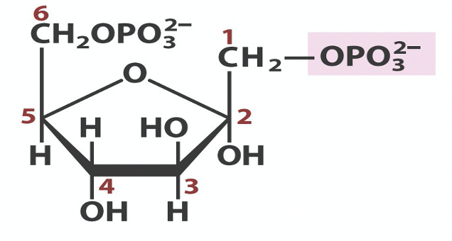
Reverse Process of Glycolysis
Mg²⁺
Mg²⁺
Mg²⁺
Mg²⁺
+
H₂O
ATP
ADP+Pi
Pi
PEP
2-phosphoglycerate
3-phosphoglycerate
1,3-phosphoglycerate
3-PGAld
Mg²⁺
Pyruvate
Pi
Glucose
Glucose 6-phosphate
Fructose 6-phosphate
Fructose 1,6-phosphate

Slide 8
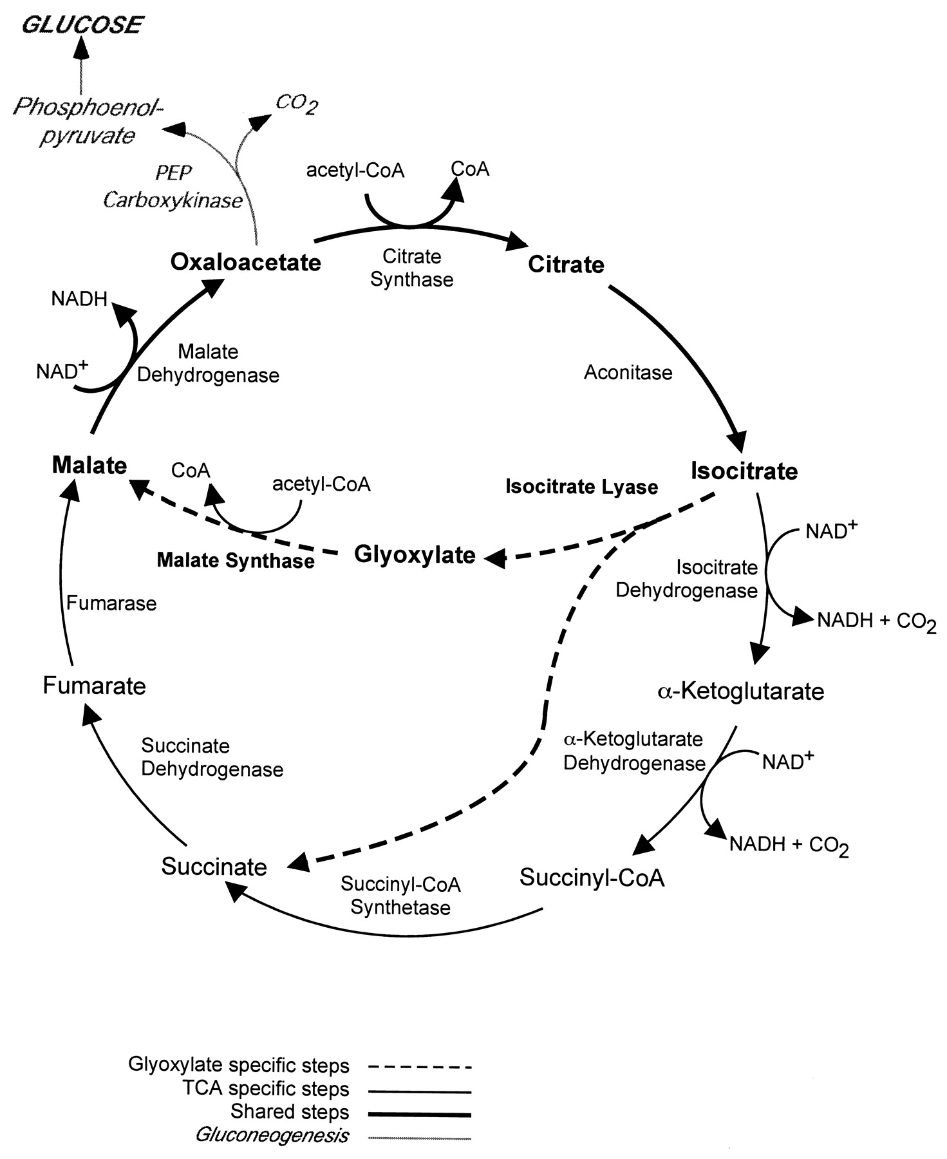
Glyoxylate Cycle
In animal cell, glucose cannot be synthesized from acetyl-CoA. In this case, it is impossible for animal to convert fatty acid to glucose. However, in some kind of seed, with the existence of glyoxysome and isocitrate lyase, acetyl-CoA can be the material of gluconeogenesis.

Slide 9
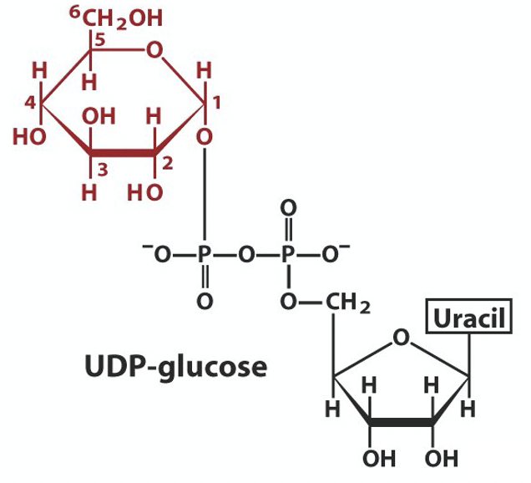
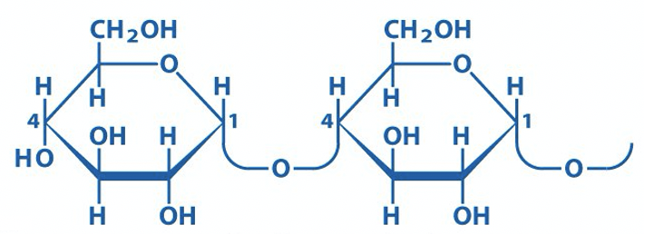
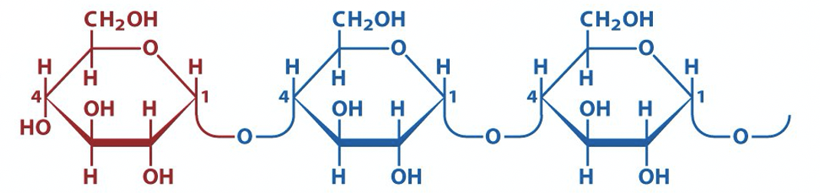
Synthesis of Glycogen
Phosphoglucomutase
Glucose 6-phosphate
Glucose 1-phosphate
UDP-glucose pyrophosphorylase
UDP-Glucose
+
Nonreducing end of glycogen with n residues
Branched Glycogen
Glucose synthase
glycosyl-(4→6)-transferase
Glycogen with n+1 residues

Slide 10
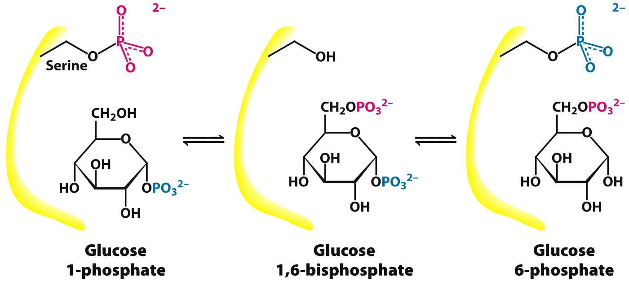
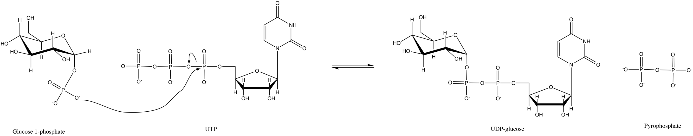
Reactions in Glycogen Synthesis
Phosphoglucomutase
UDP-glucose pyrophosphorylase

Slide 11
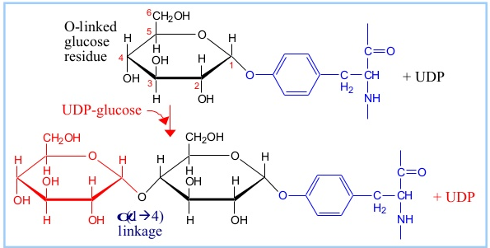
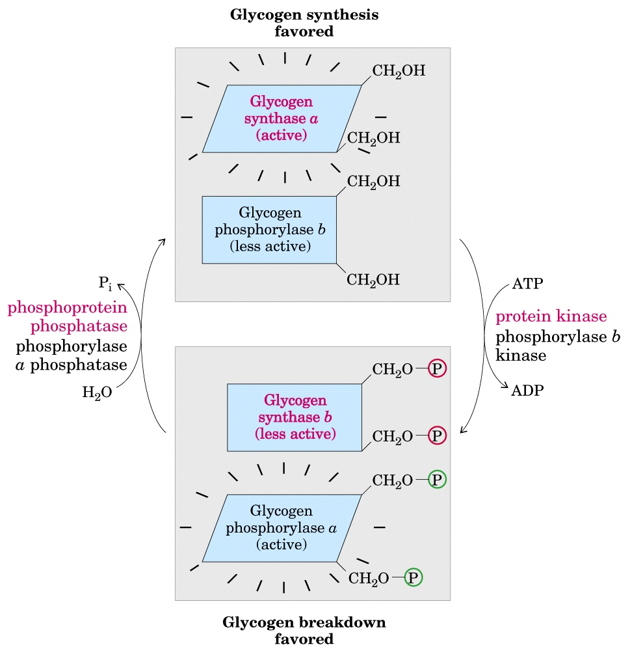
Properties of Glycogen Synthase
1. The beginning of glycogen synthesis need a particular protein called glycogenin, which contains a Tyr residue to accept first glucose residue.
2. Regulation of glycogen synthase:
When which is phosphorylated, its activity is inhibited whereas when dephosphorylated, it is activated. This reversible phosphorylation is regulated by PP1 (Phosphoprotein phosphatase) and GSK3 (Glycogen Synthase Kinase).

Slide 12
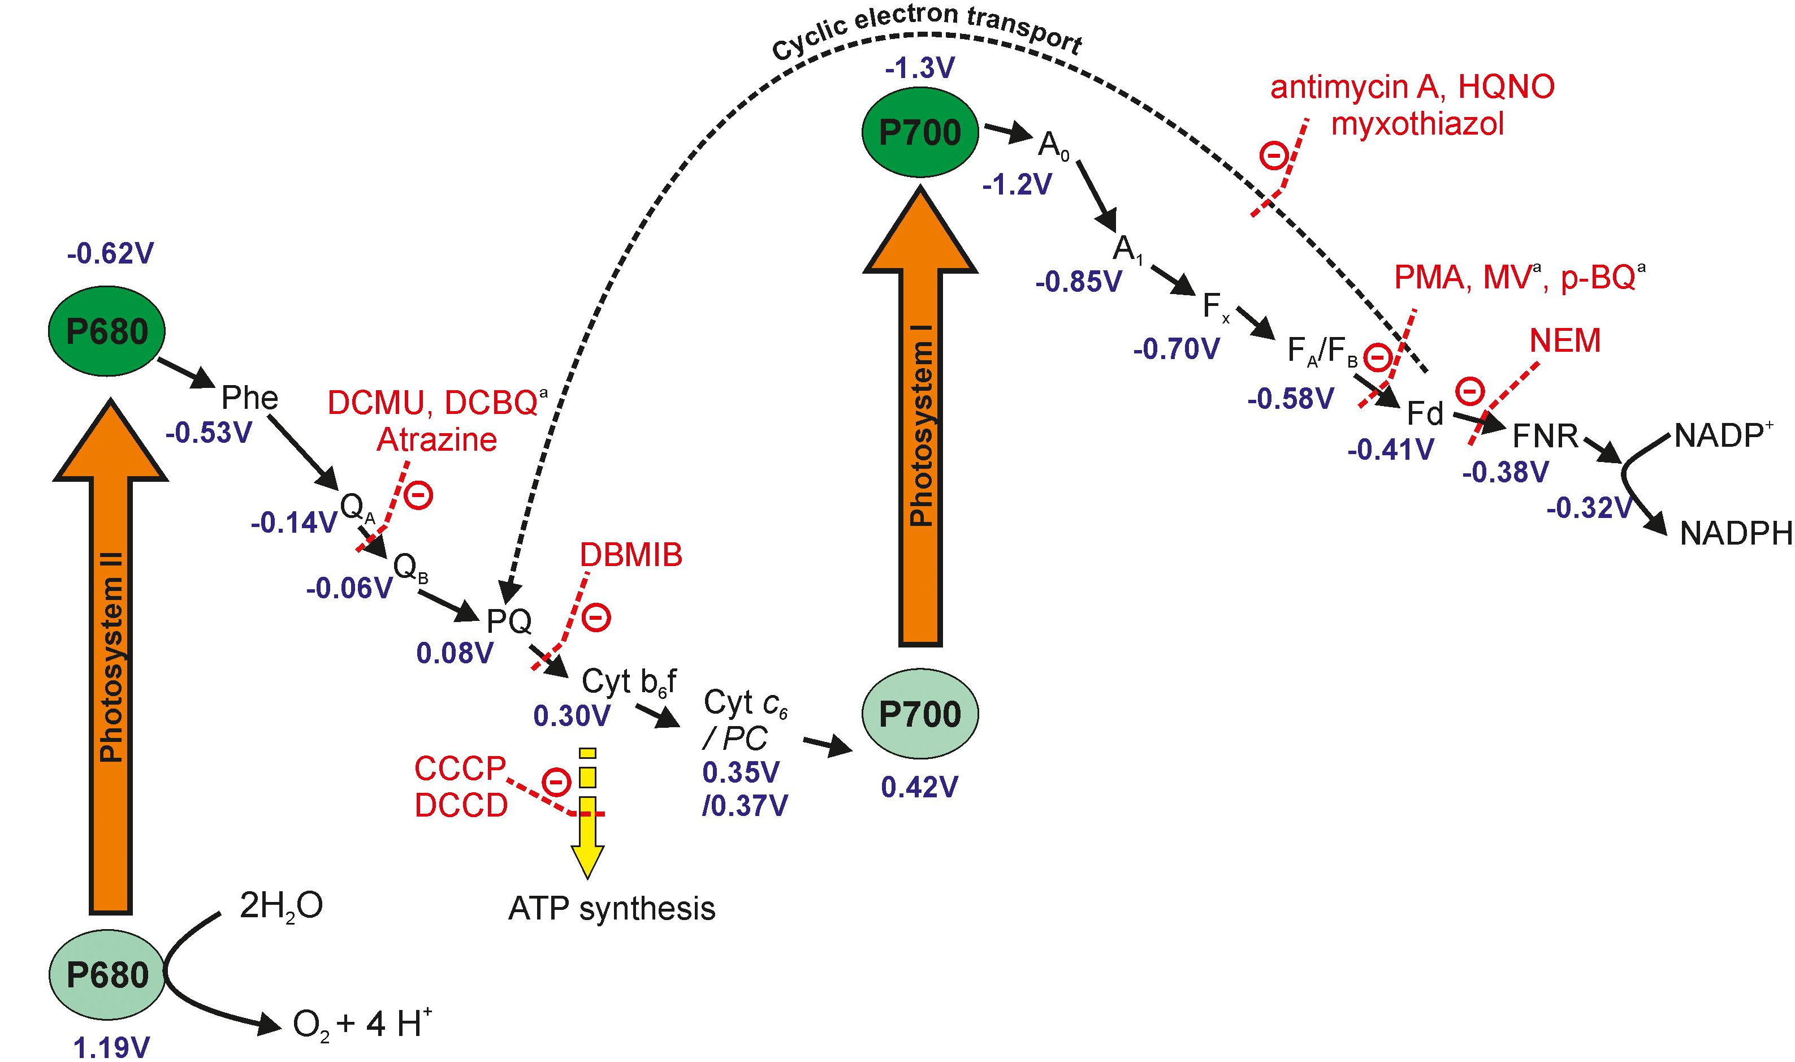
Photosynthesis
In the photosynthesis, energy in light is stored in NADPH and ATP. In further carbon reaction, the energy and reducing power will be used to fix CO₂ and synthesis carbohydrate.
8 photons + 2H₂O → 4H⁺ + O₂ + 2NADPH + 3ATP
Two Photosystems
Synthesis of ATP
Pigments

Slide 13
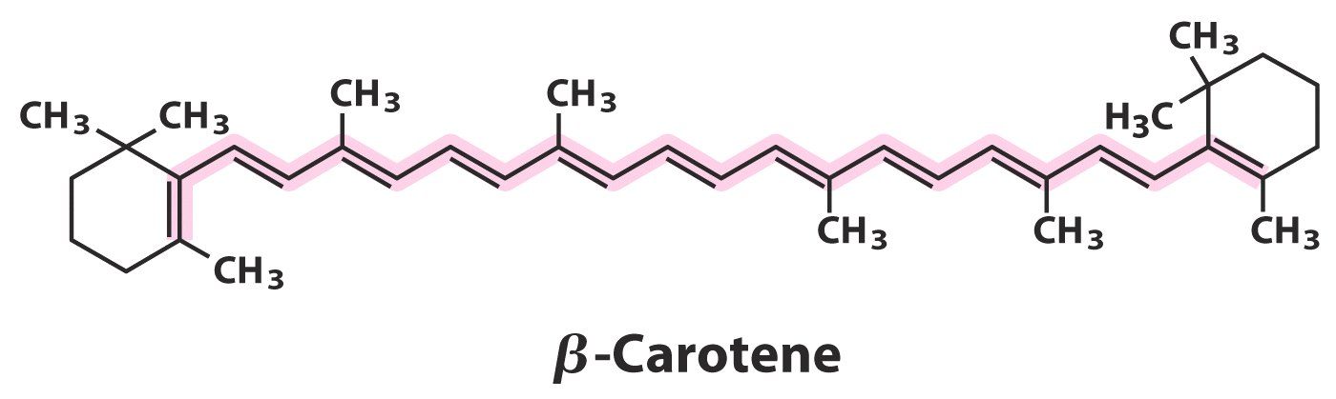
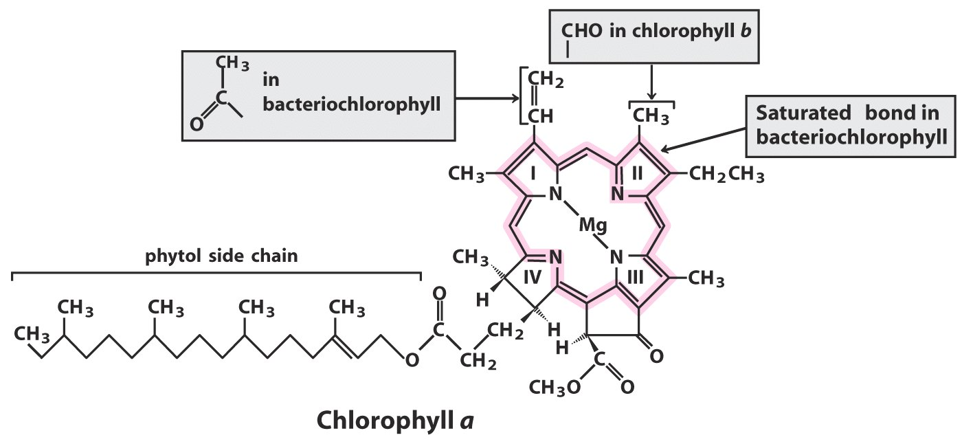
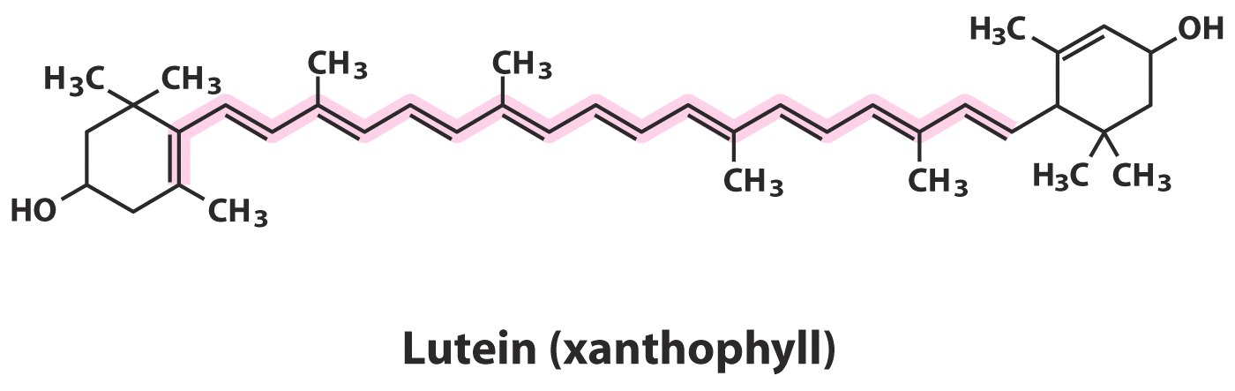
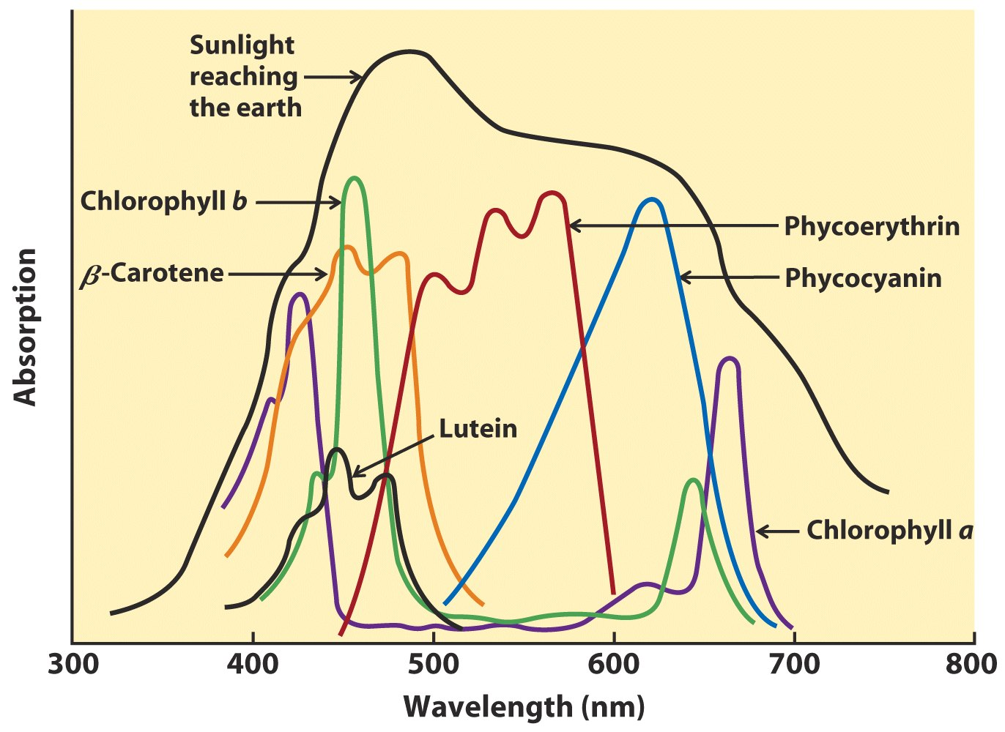
Photosynthesis Pigments
Only the special chlorophyll a pair can transfer electrons, which is called “Reaction Centre Pigments”.
Other pigments are “accessory pigments” that collect energy.

Slide 14
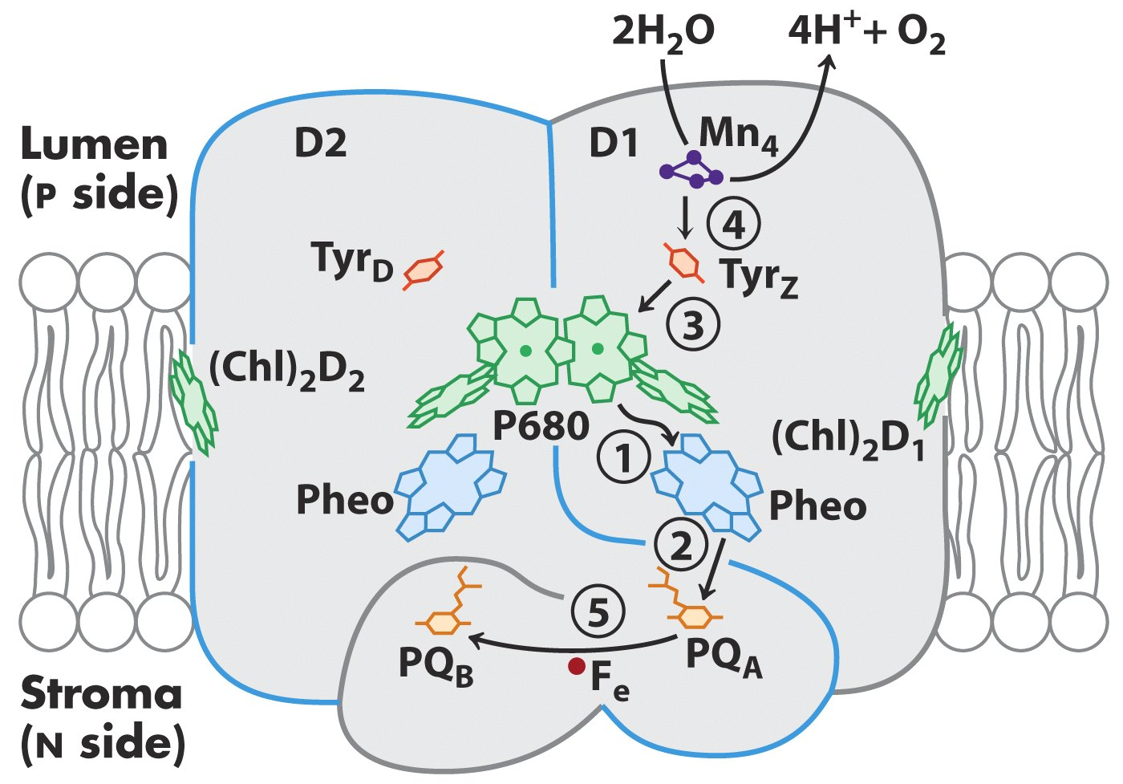
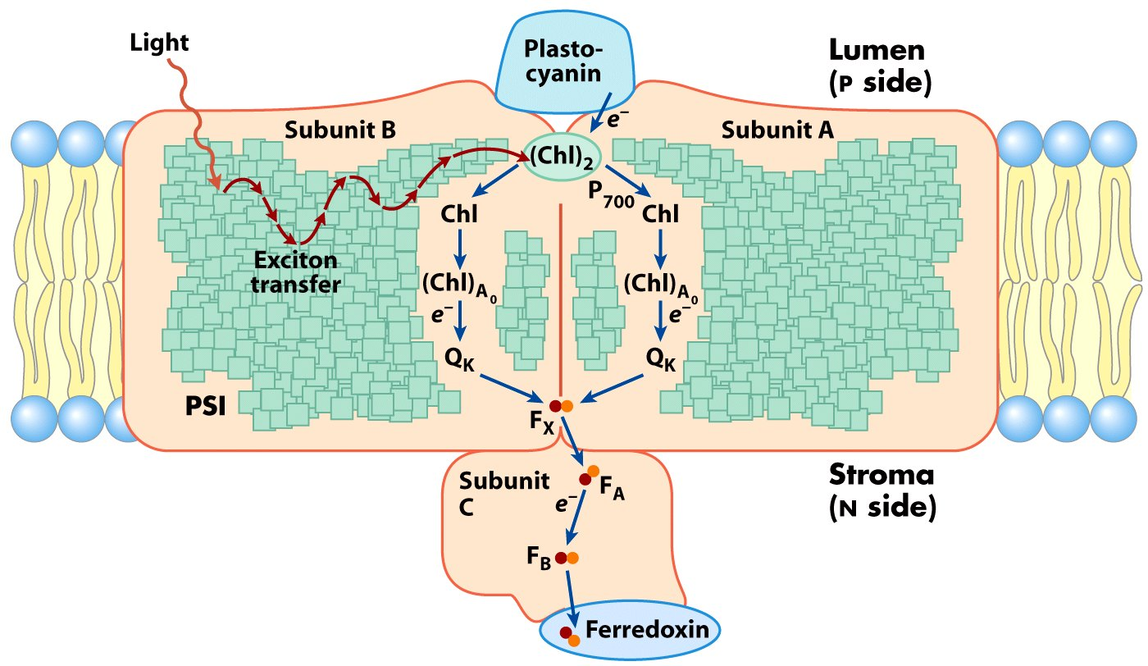
Two Photosystems
PSII:
The photolysis of water provide electrons to the electron transferring chain. Proton is released to generate proton gradient cross thylakoid membrane.
PQ_{B} also brings proton to thylakoid lumen.
PSI:
Electrons are finally transported to NADP⁺, which would act as the reducing power to fix CO₂.

Slide 15
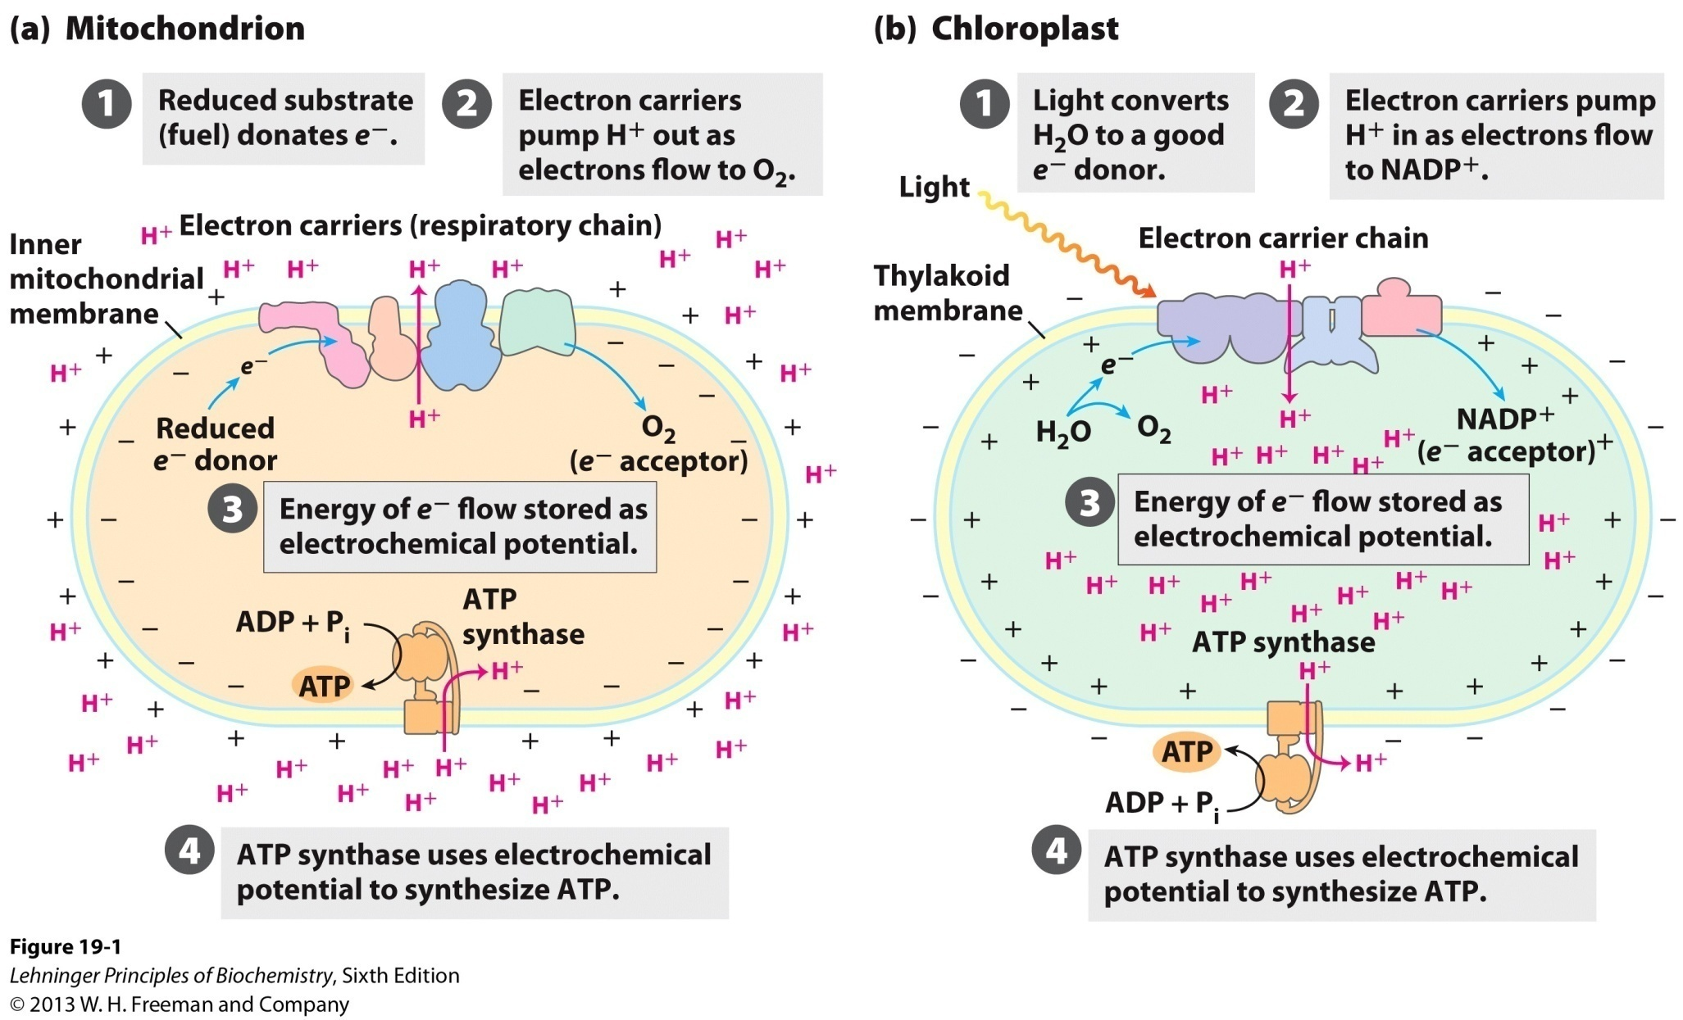
ATP-synthesis --- Photophosphorylation
Which is quite similar mechanism to oxidative phosphorylation in mitochondria

Slide 16
Calvin Cycle
CO₂
Ribulose 1,5-biphosphate
Rubisco
ADP+Pi
ATP
Carbon fixation
3-phosphoglycerate
ATP
Ribulose 5-phosphate
ADP+Pi
Reduction
1,3-biphosphoglycerate
RuBP Synthesis
NADH+H⁺
3-phosphoglycealdehyde
NAD⁺
3CO₂ + 9ATP + 6NADPH
glyceraldehyde 3-phosphate+ 9ADP + 8P_{i} + 6NADP⁺

Slide 17
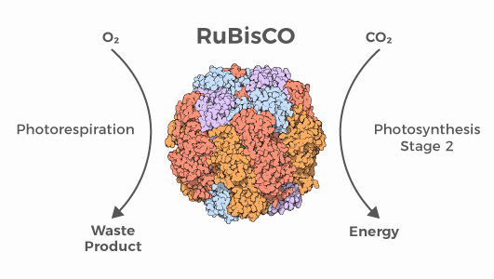
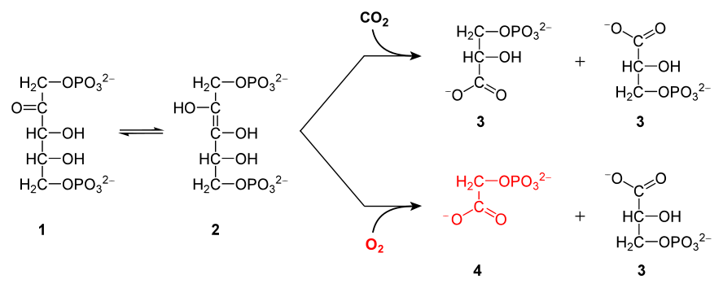
Ribulose 1,5-biphosphate Carboxylase/Oxygenase
Rubisco is the most abundant protein in earth.
It contains 16 subunits.
Catalyze two different reaction:
Carboxylase: Calvin Cycle.
Oxygenase: Photorespiration.

Slide 18
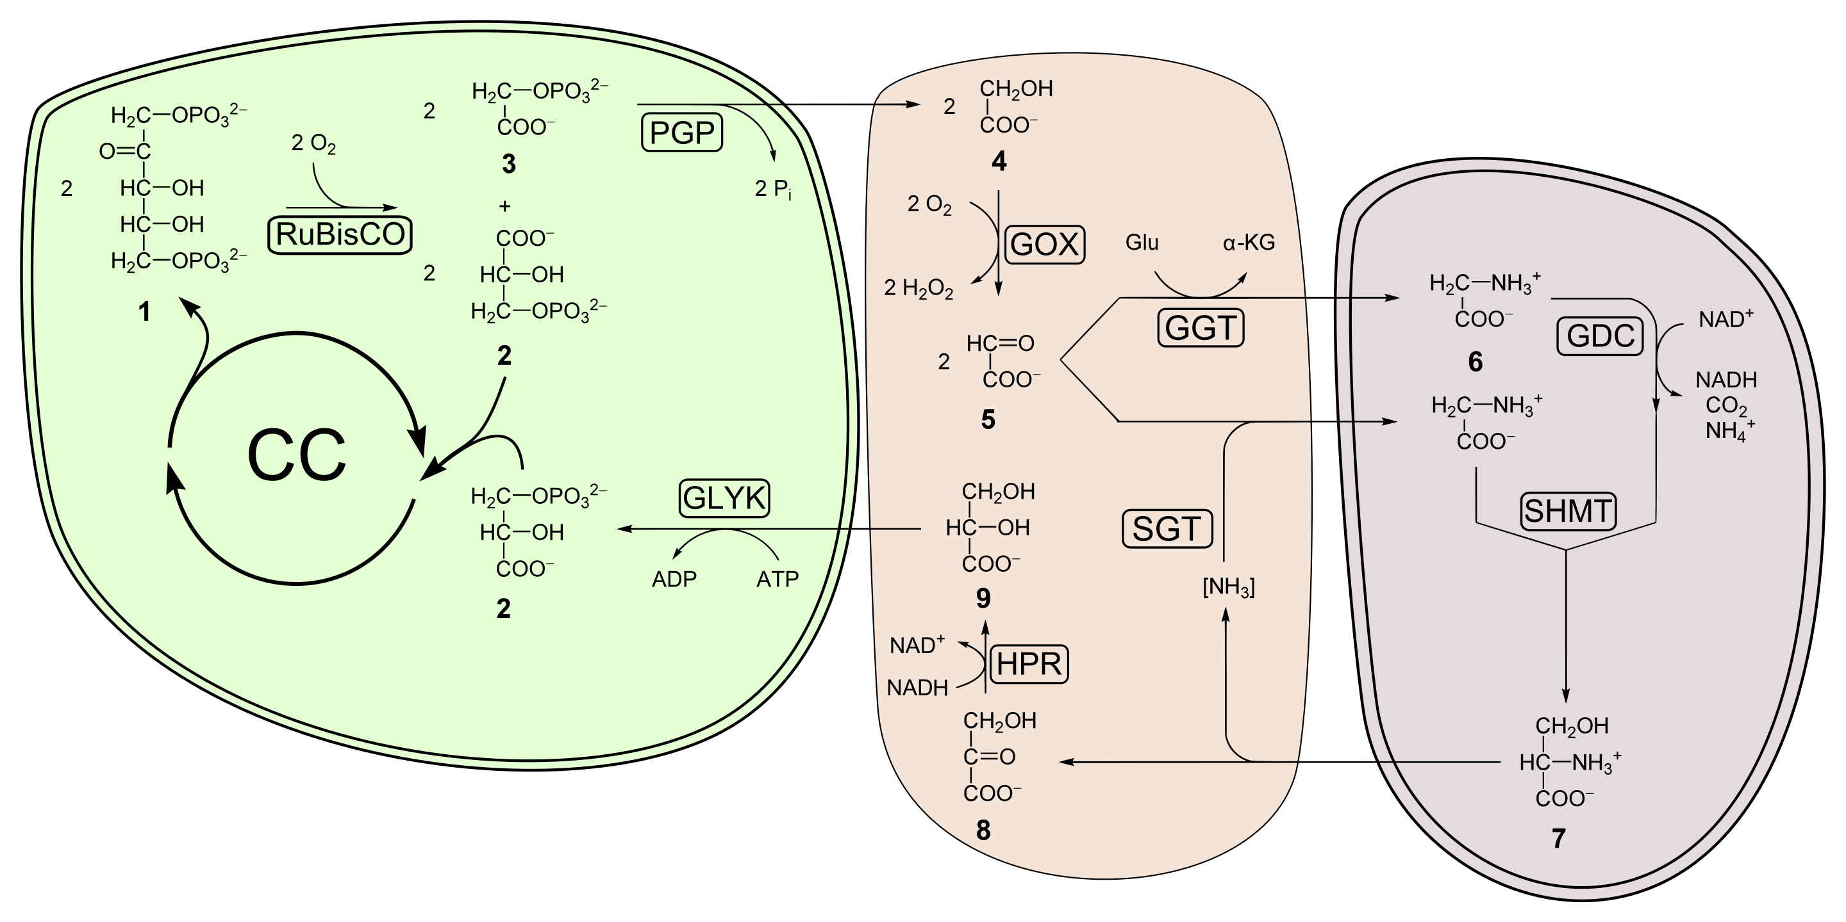
Photorespiration
Photorespiration (also known as the oxidative photosynthetic carbon cycle, or C2 photosynthesis) refers to a process in plant metabolism where the enzyme Rubisco oxygenates RuBP, wasting some of the energy produced by photosynthesis.

